Slide 1
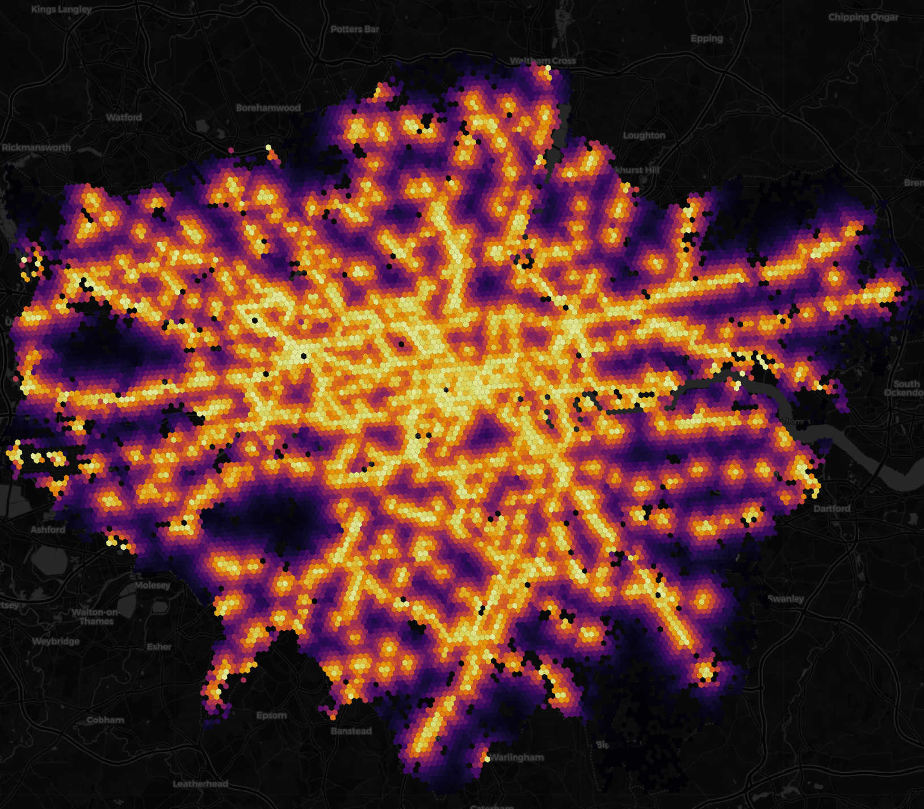
London in the Pandemic Era:
Consequences and Implications of COVID-19
Caroline Cullinan & Leonardo Nicoletti
Prepared for Enders Analysis

Slide 2
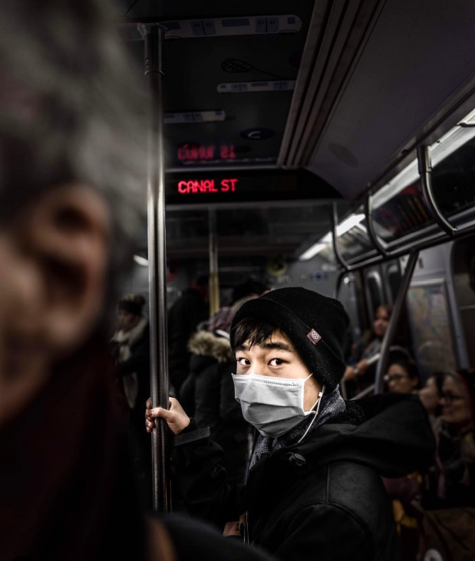
Overview
Methodology & Concepts
An Introduction to COVID-19 and Mobility in London, UK: Setting the Scene
Disaggregating London: COVID-19 & Mobility by Borough
Disaggregating Mobility in London: Identifying Major Shifts in Urban Lifestyles
The Impact of Reduced Mobility: London CBD As A Case Study
How Does London Compare?

Slide 3
Methodology & Concepts

Slide 4
Data
1. The Health Foundation COVID-19 Policy Tracker: Timeline of national policy and health system responses to COVID-19 in England
2. Greater London Authority Coronavirus (COVID-19) Cases: Public Health England (PHE) daily updated data on confirmed COVID-19 cases
3. Google COVID-19 Community Mobility Reports: A record of movement trends over time by geography for different categories of places
Retail & Recreation
Essential Services
Workplaces
Residential Areas
Public Transportation
Data shows how visitation to different categories of place have changed when compared to the baseline days
Baseline
Calculated per day (i.e. Monday, Tuesday Wednesday, etc.)
Represent a normal value for that day of the week
Median value from the 5‑week period

Slide 5
Disaggregated Mobility
Daily deviation from baseline activity for each category of mobility
Retail & Recreation
Essential Services
Workplaces
Residential Areas
Public Transportation
Aggregated Mobility
Calculated mean of the following mobility categories
Retail & Recreation
Essential Services
Workplaces
Public Transportation

Slide 6
City of London is considered to be its own “borough” for better transparency as to how COVID-19 has impacted London’s economic driver
Removed Weekends (i.e. Saturday, Sunday)

Slide 7
An Introduction to COVID-19 and Mobility in London, UK: Setting the Scene

Slide 8
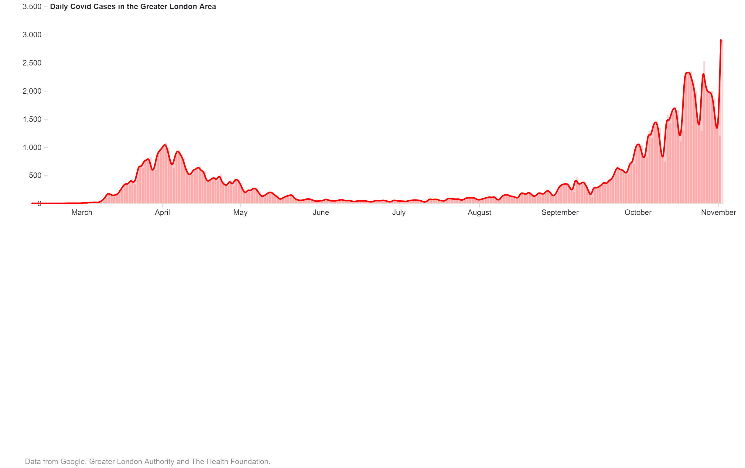

Slide 9
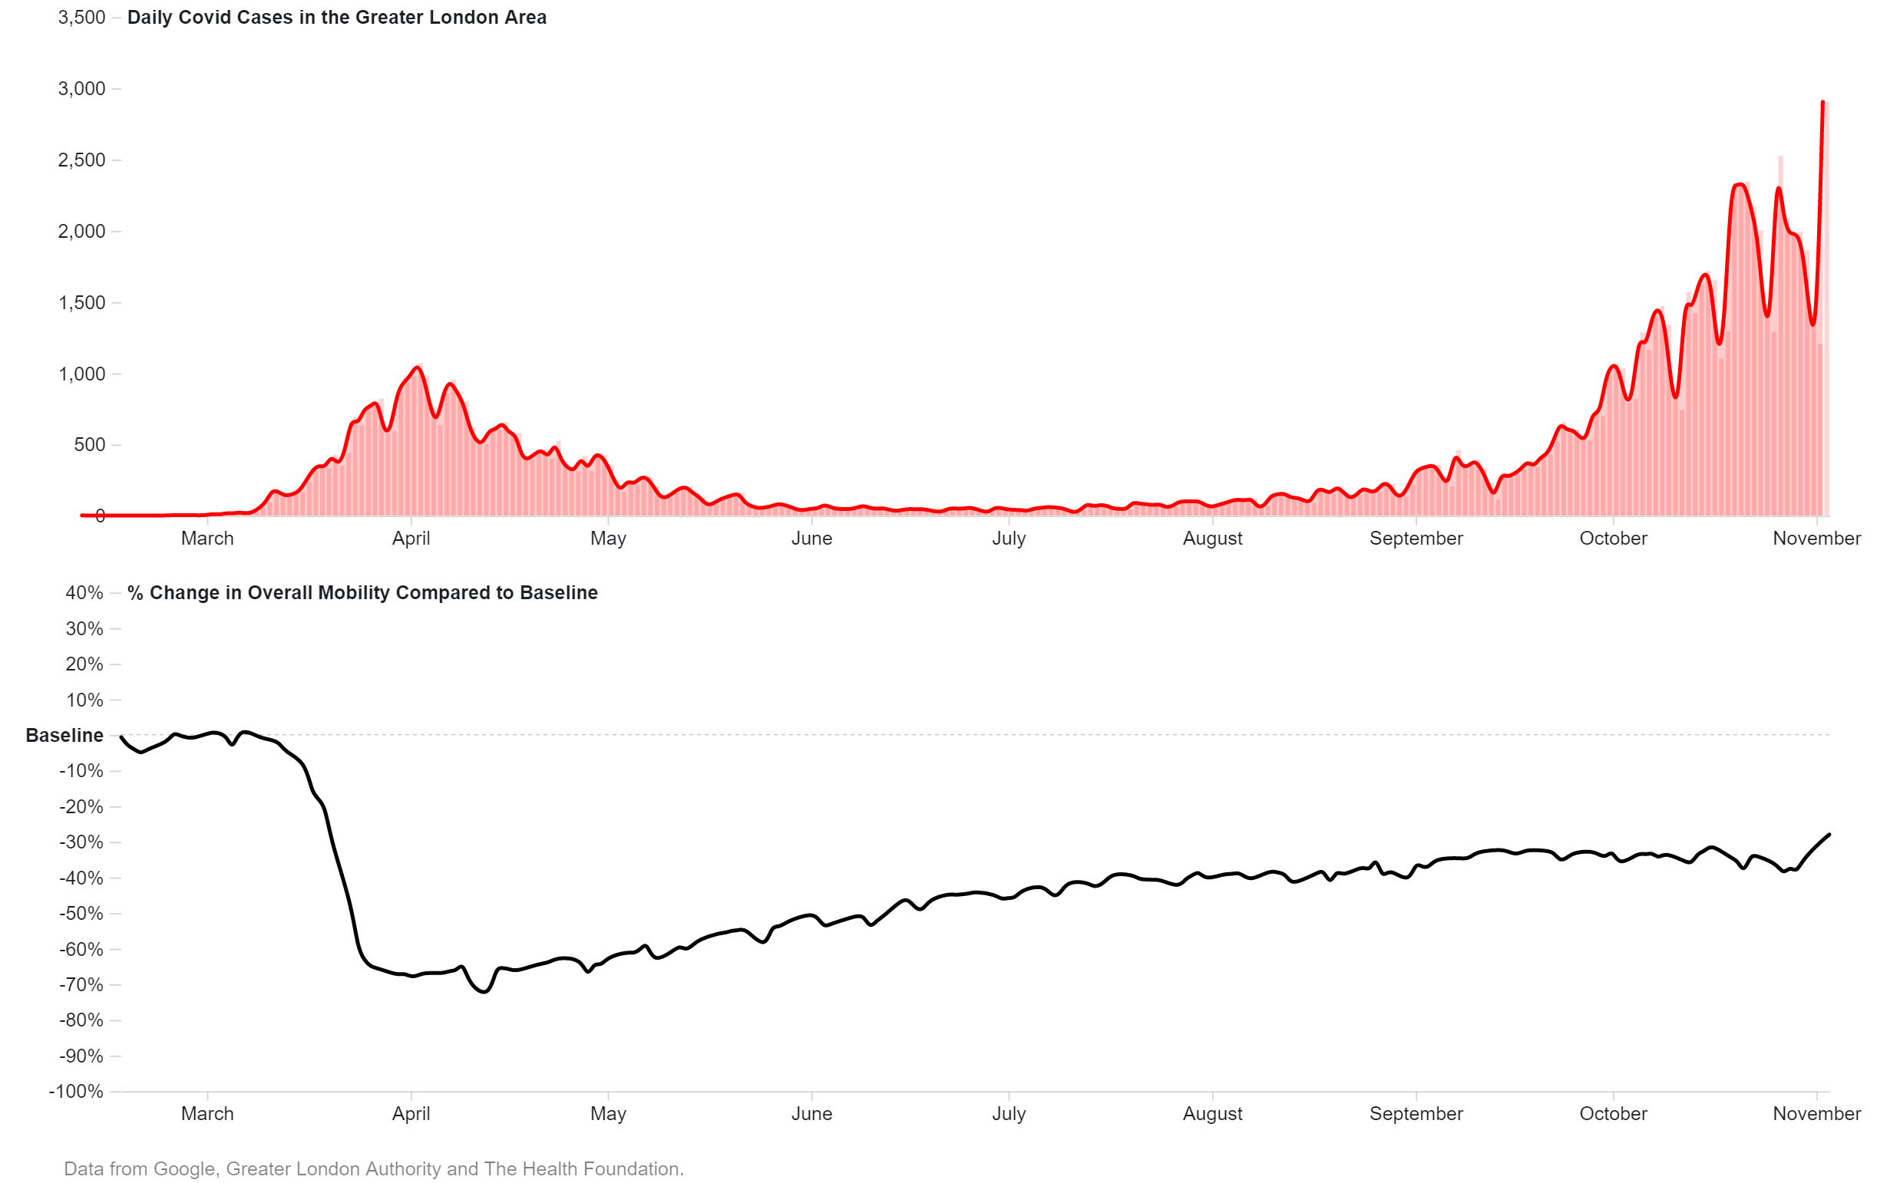

Slide 10
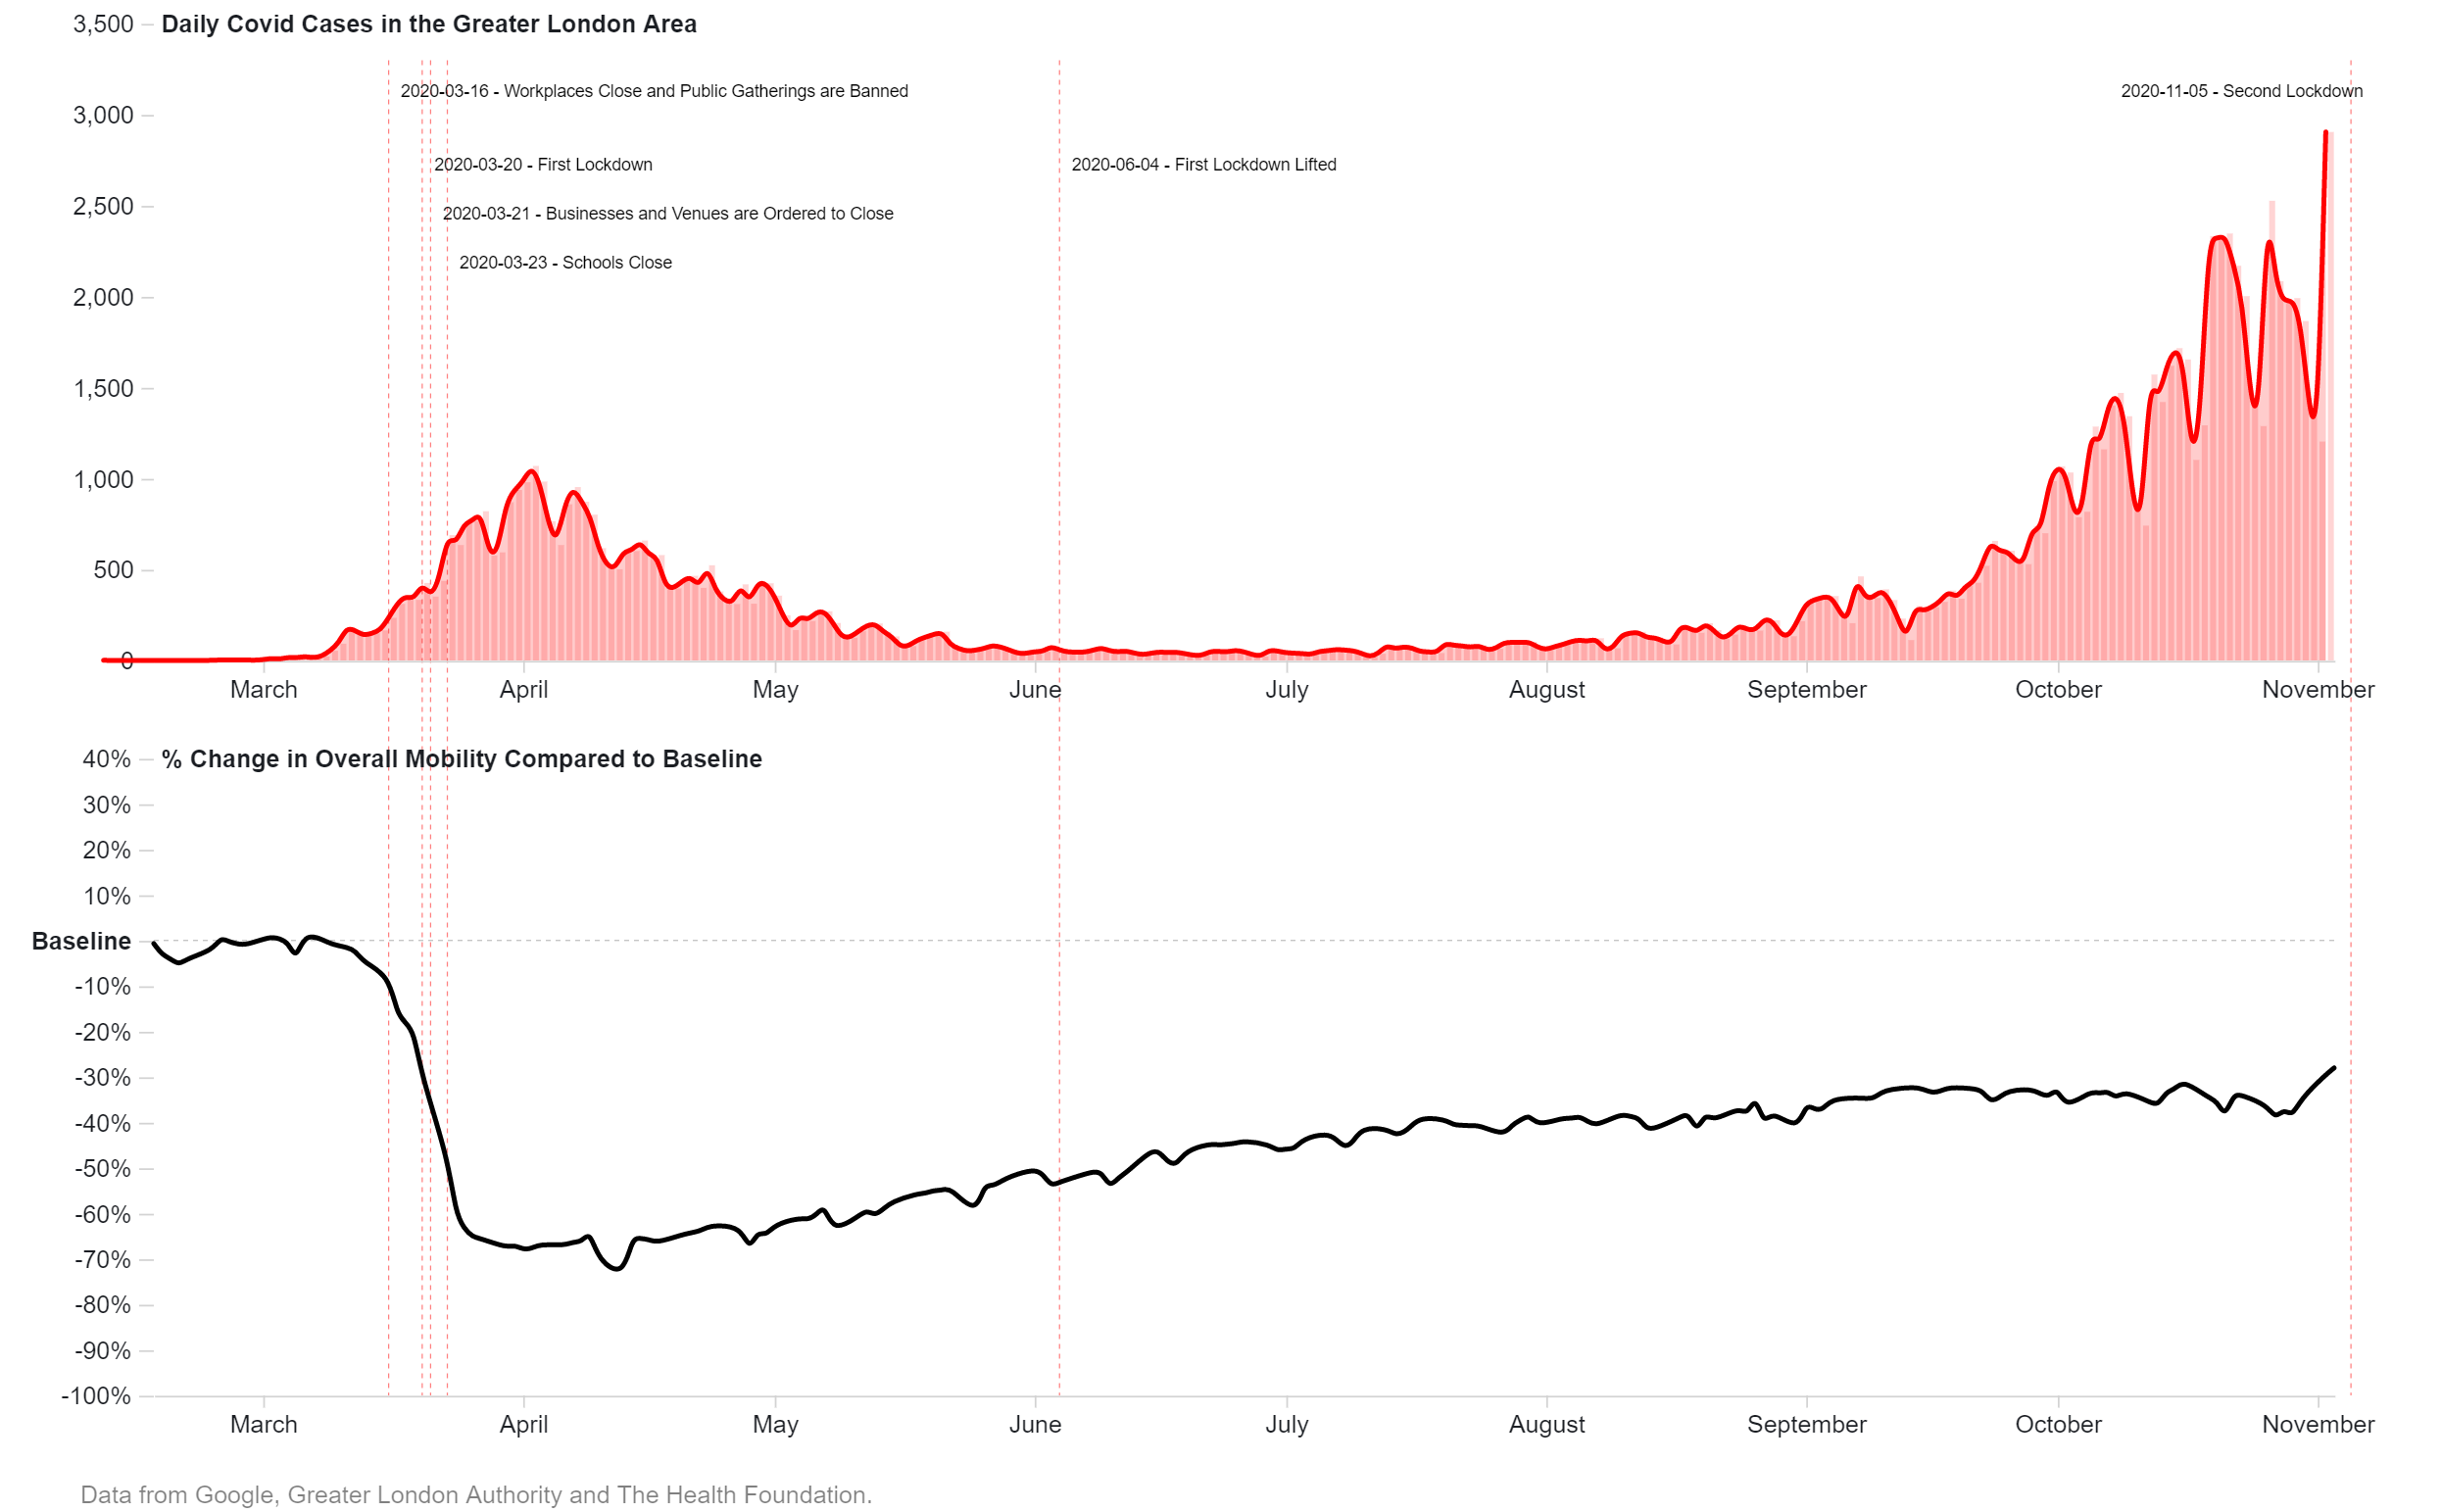

Slide 11
Disaggregating London: COVID-19 & Mobility by Borough

Slide 12
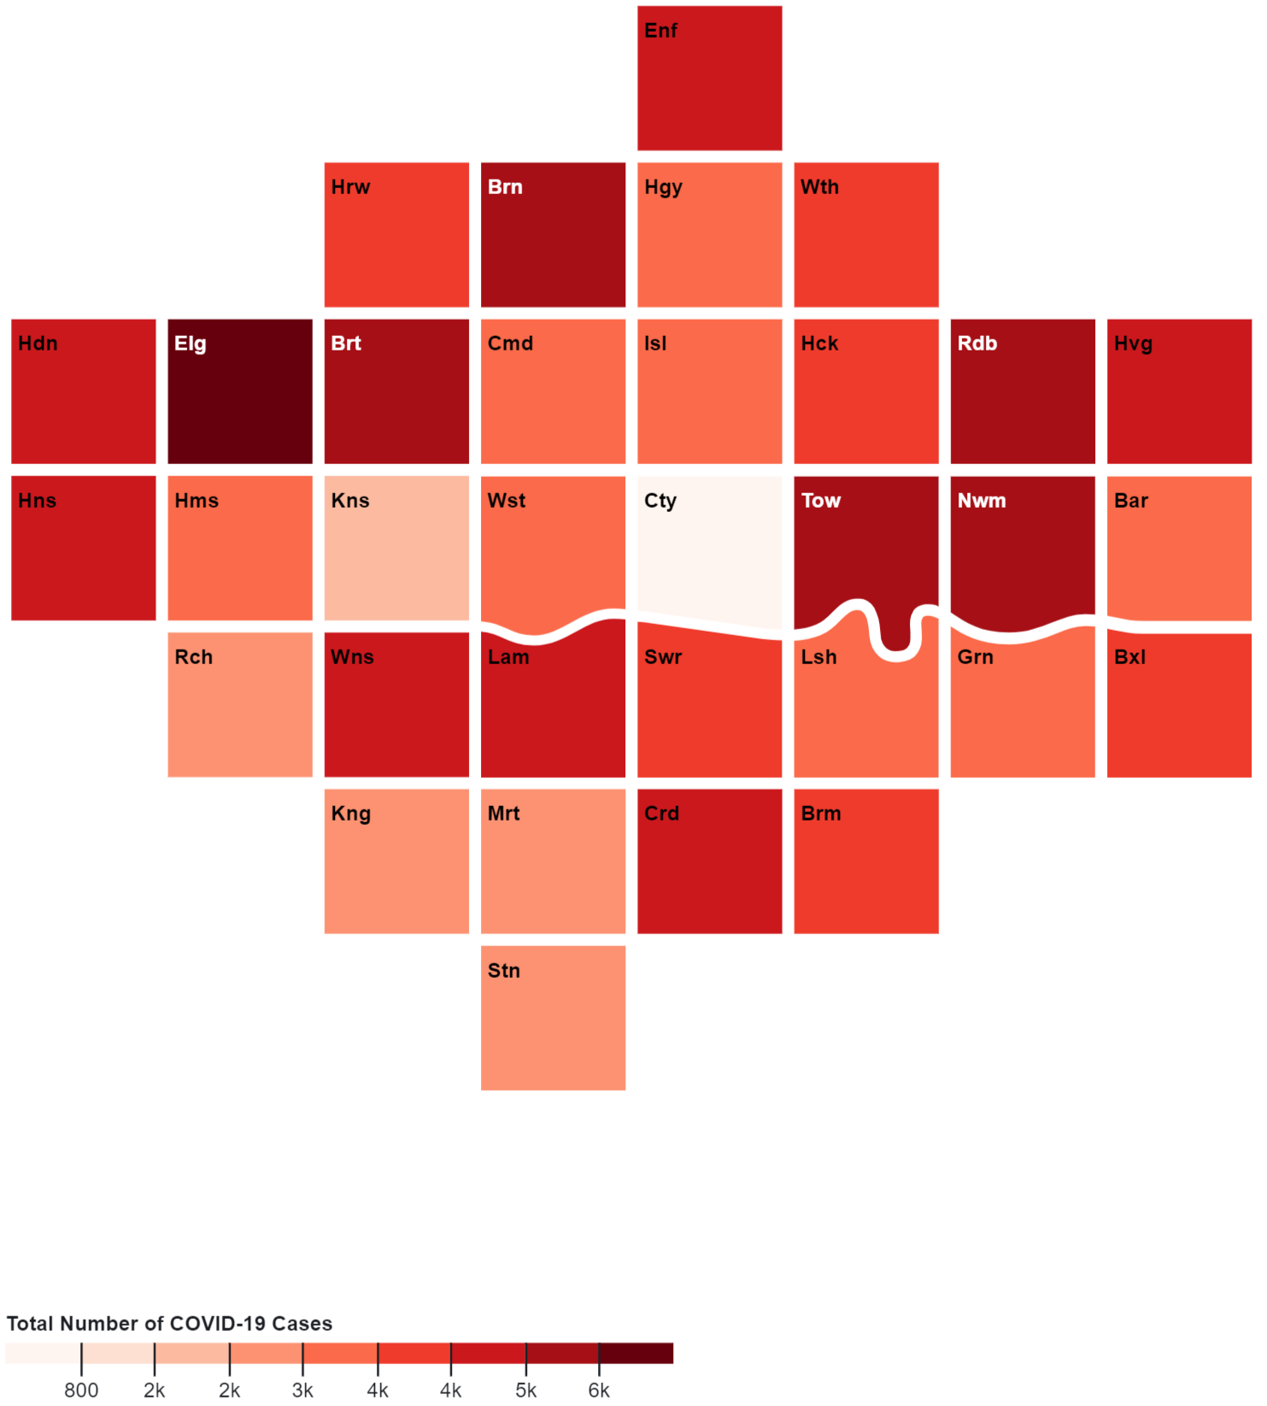
COVID-19 Cases per Borough

Slide 13
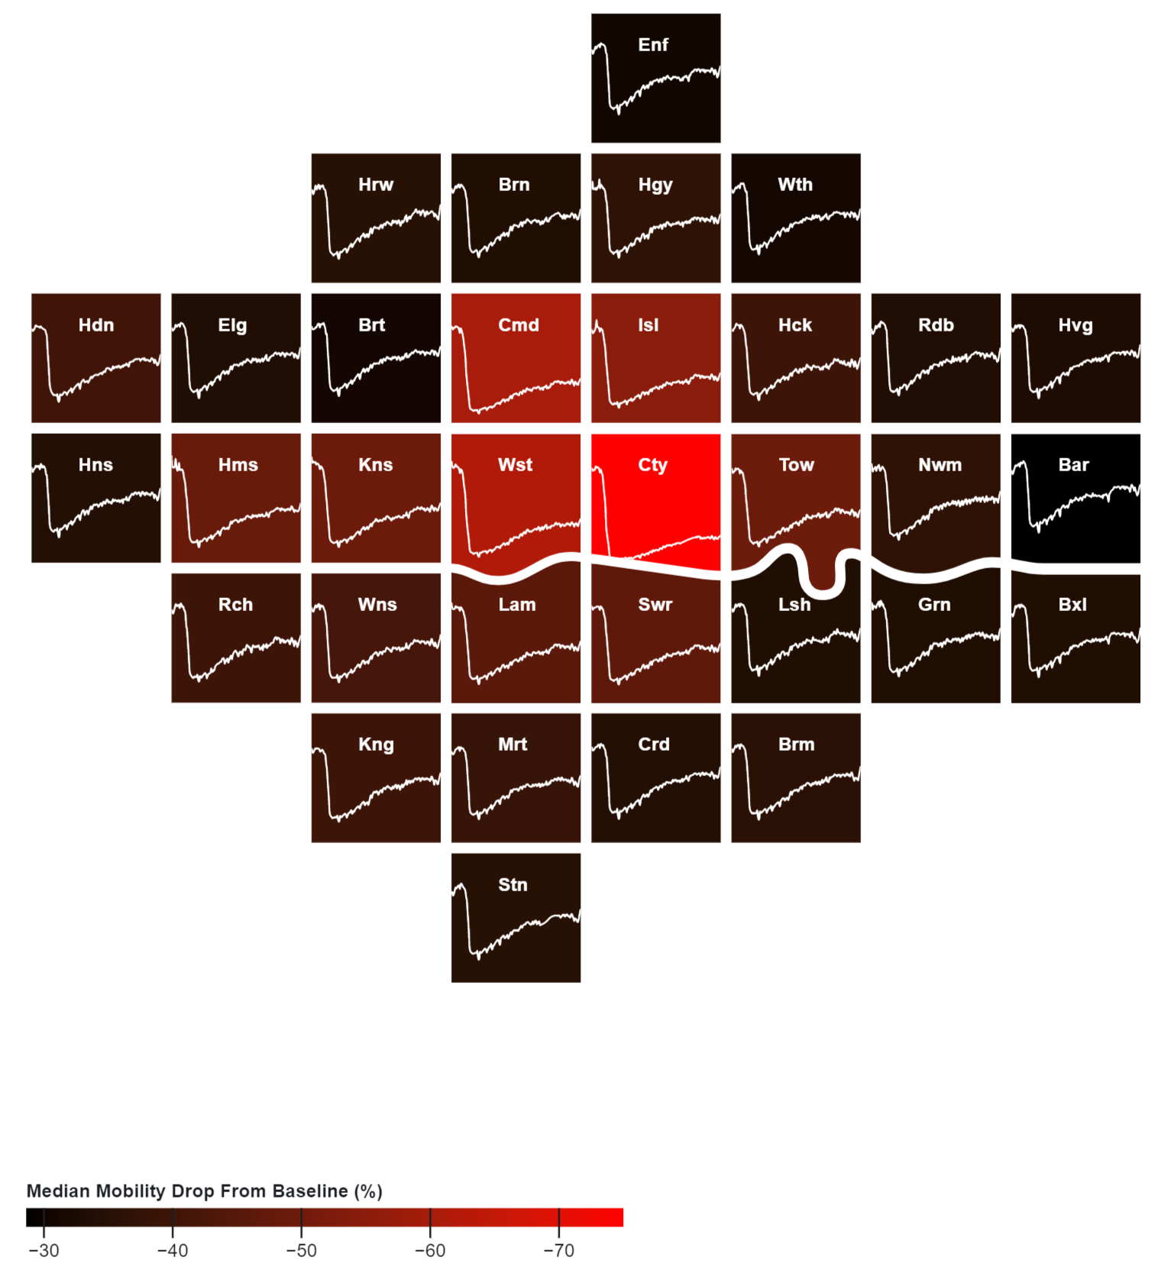
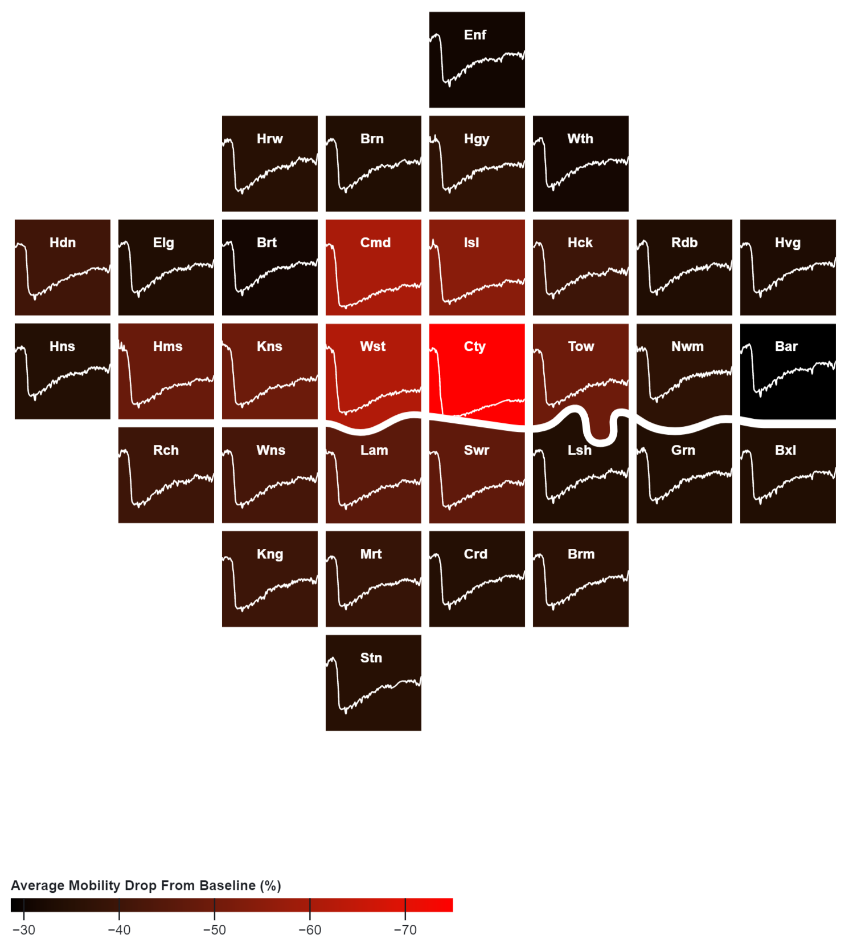
Drop in Aggregated Mobility per Borough

Slide 15
Disaggregating Mobility in London: Identifying Major Shifts in Urban Lifestyles

Slide 16
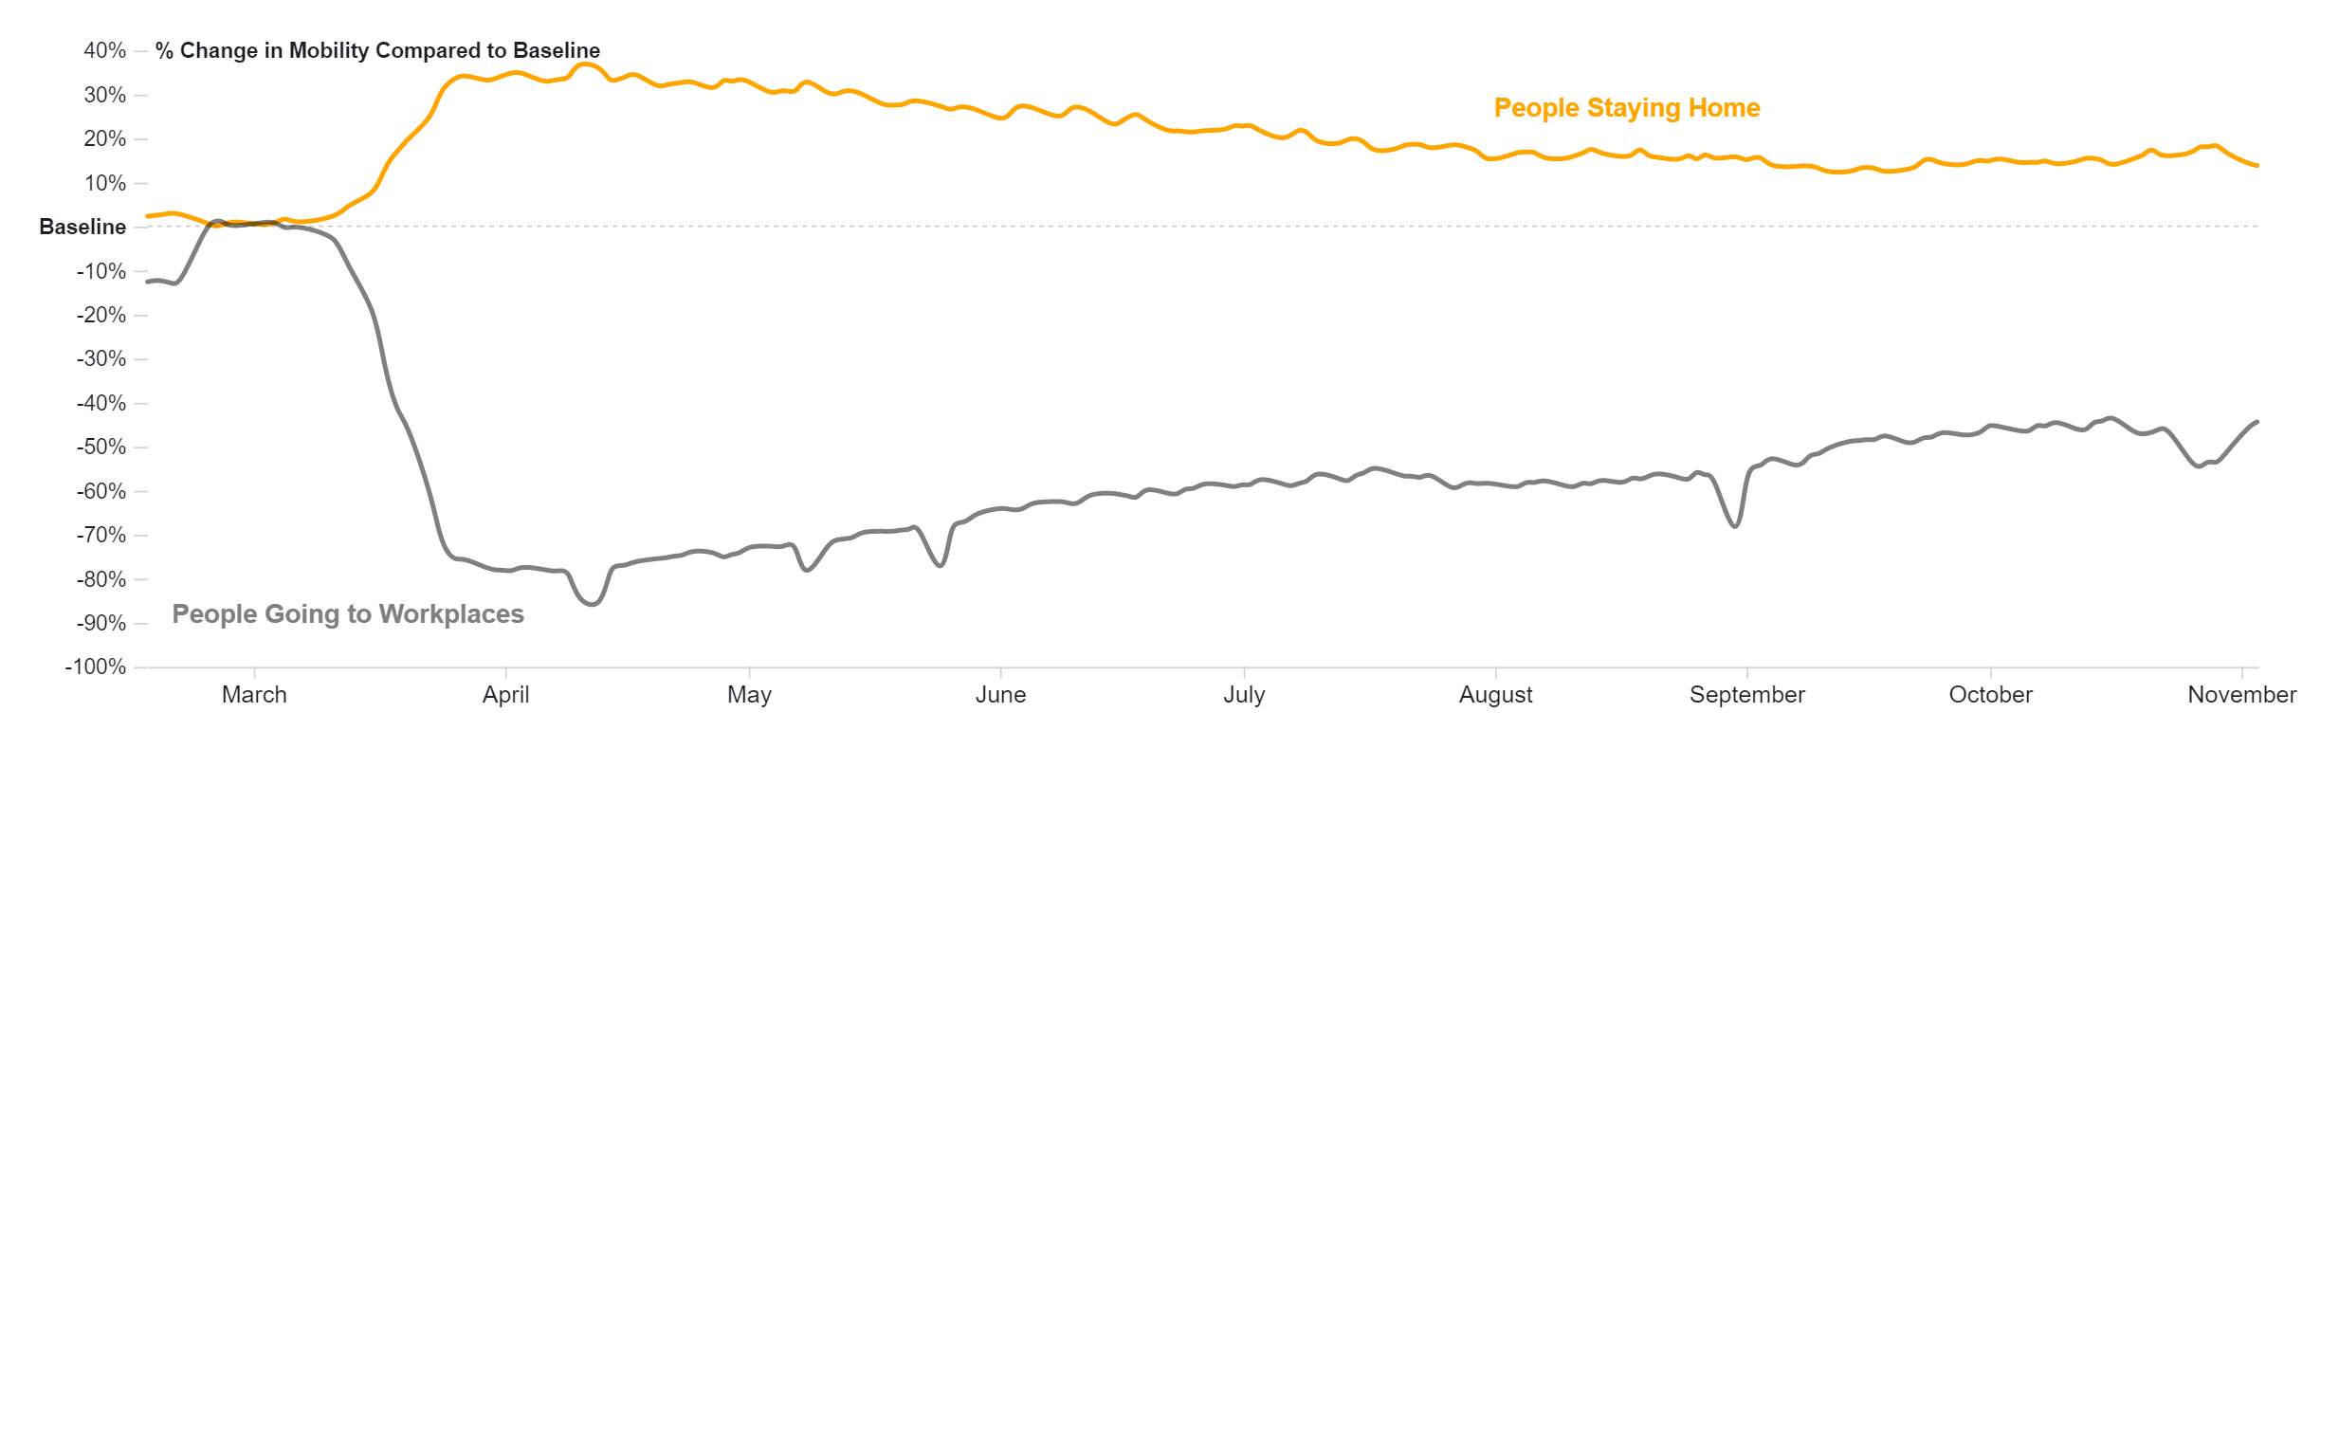

Slide 17
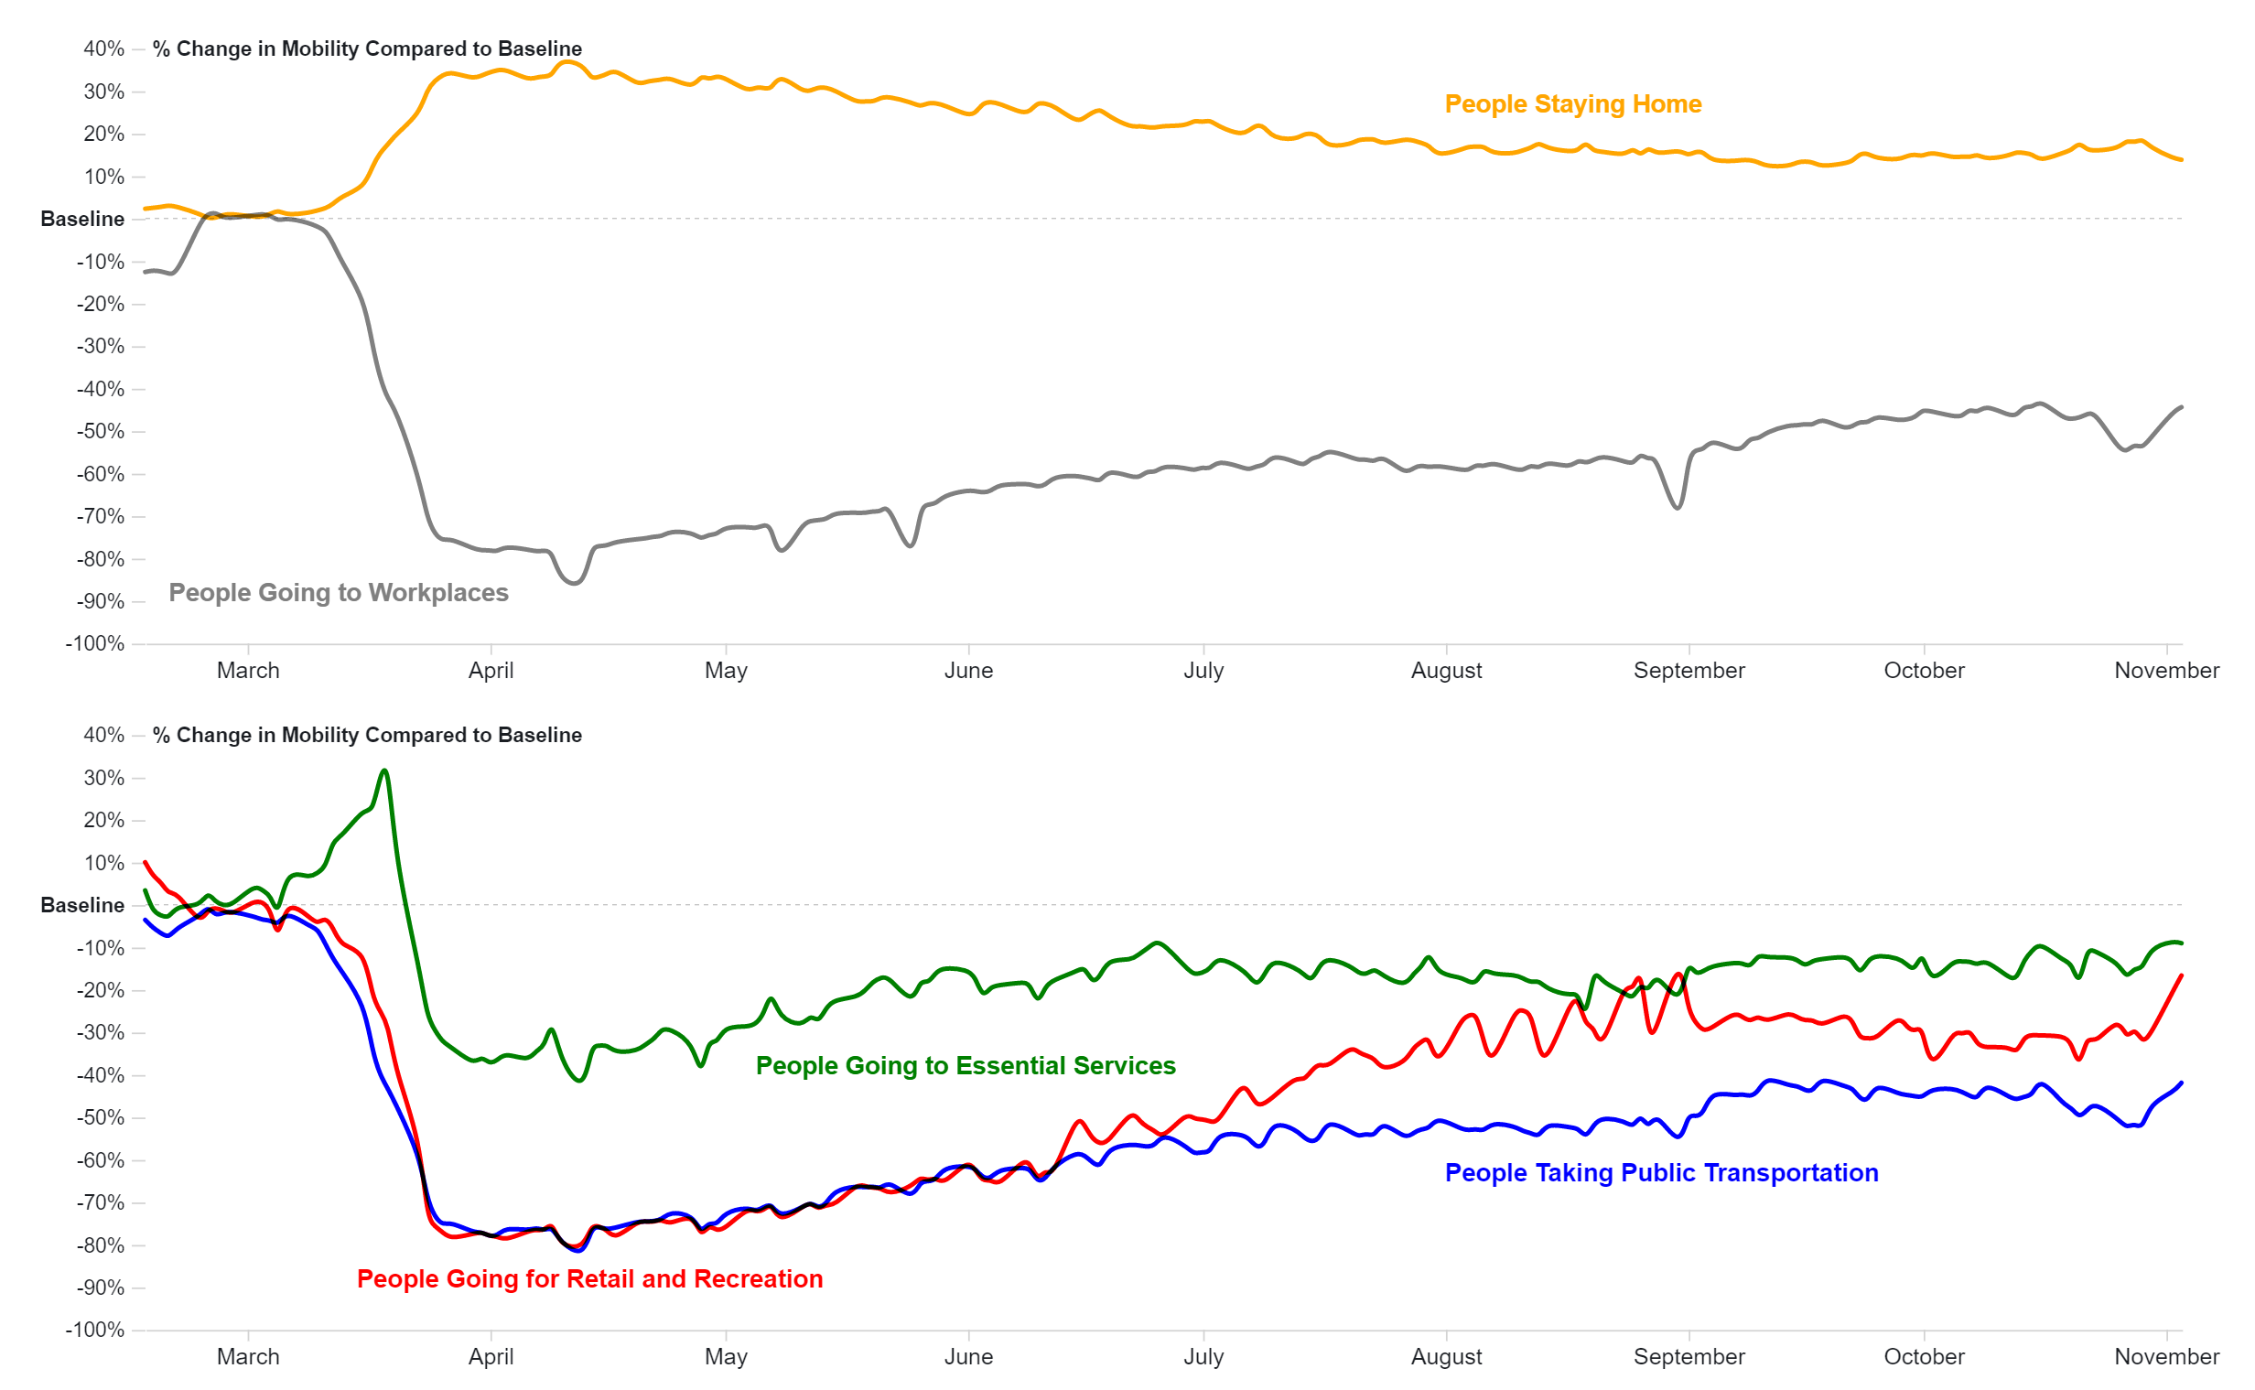

Slide 18
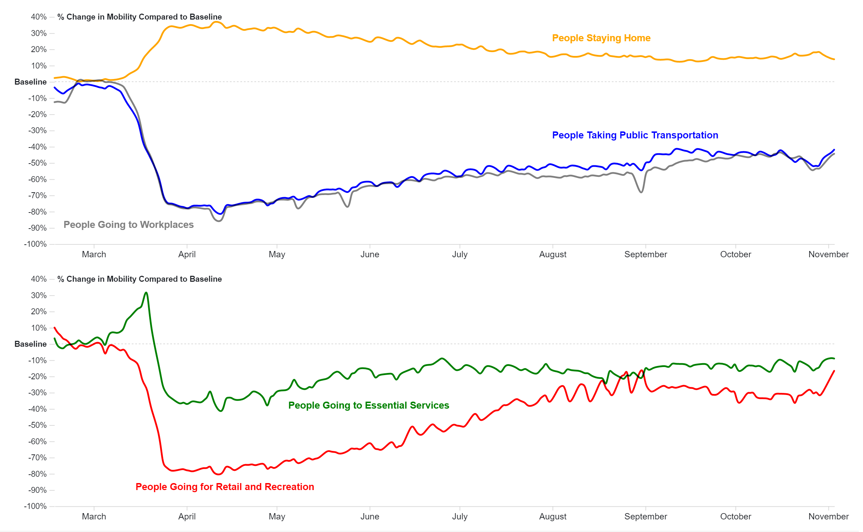

Slide 19
The Impact of Reduced Mobility: London CBD as a Case Study

Slide 20
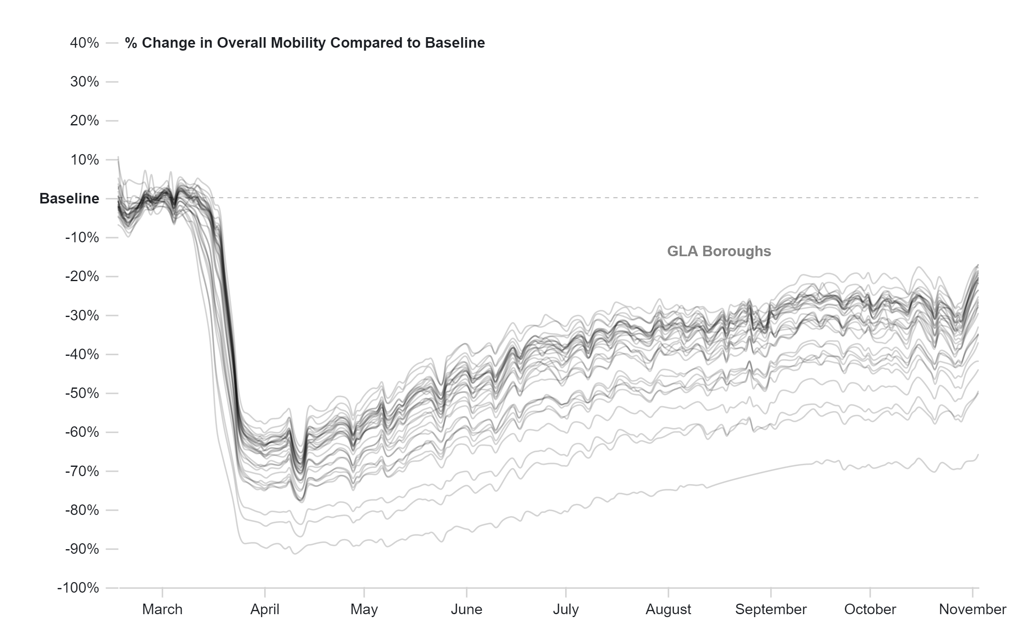

Slide 21
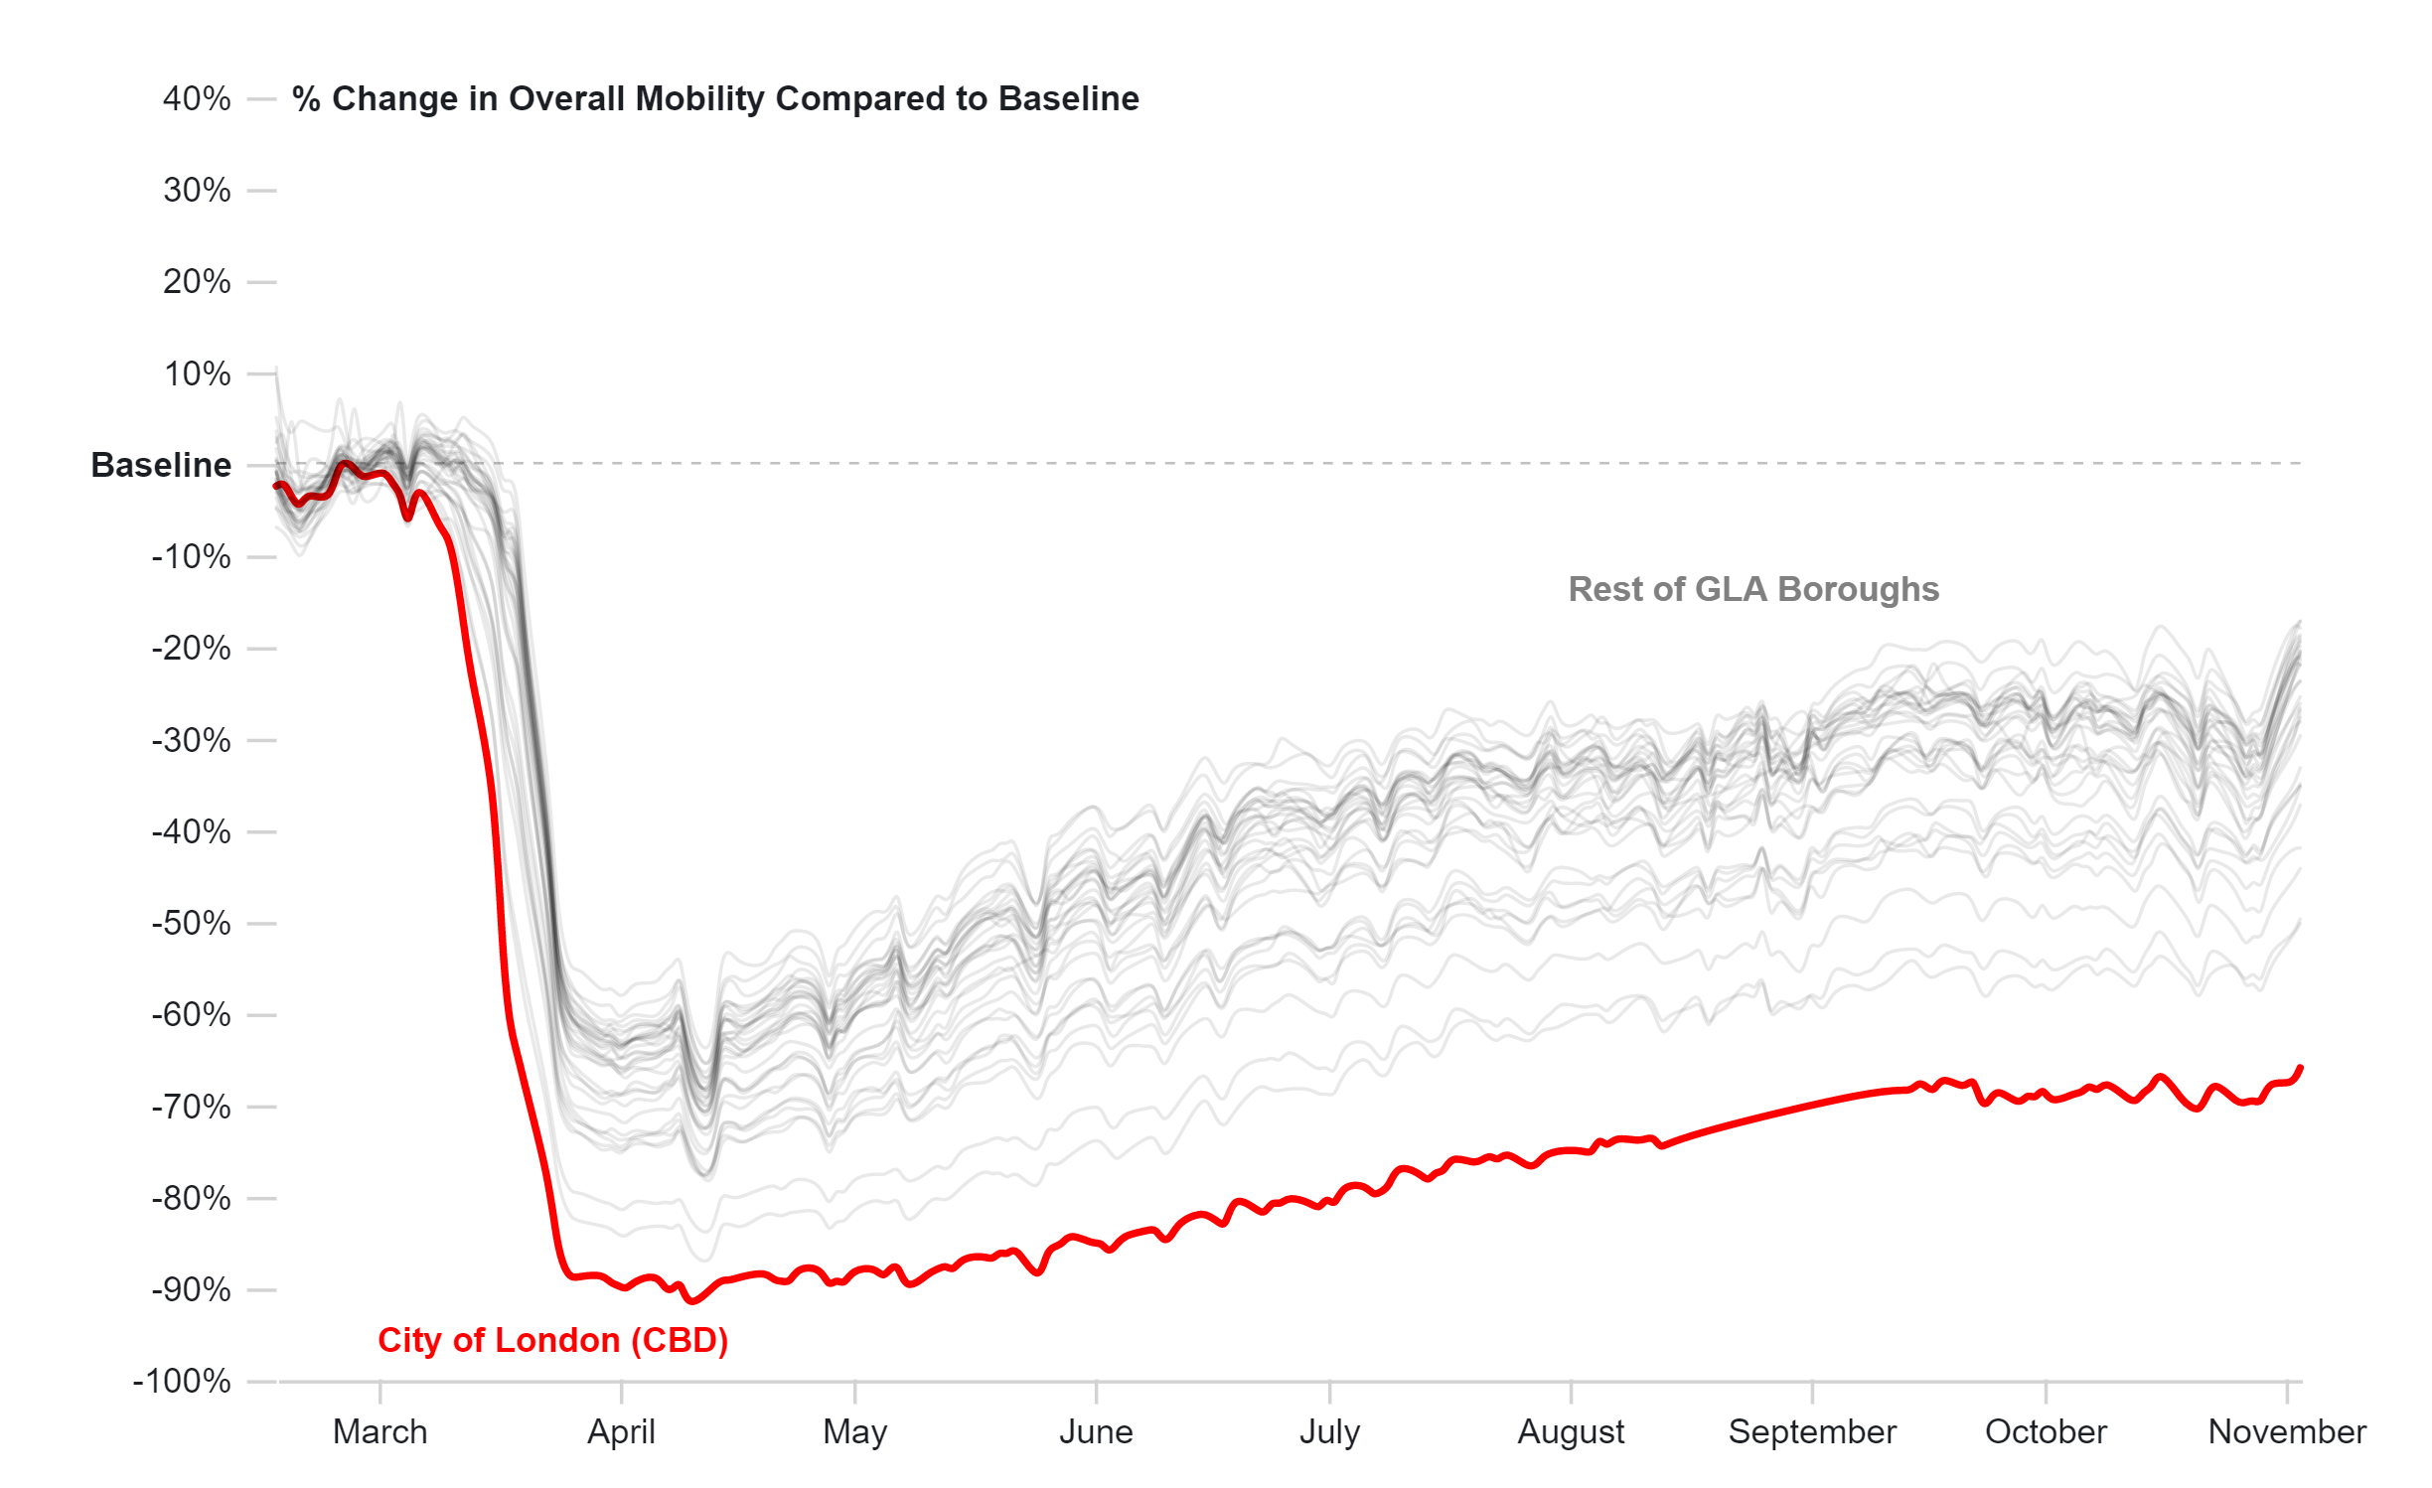

Slide 22
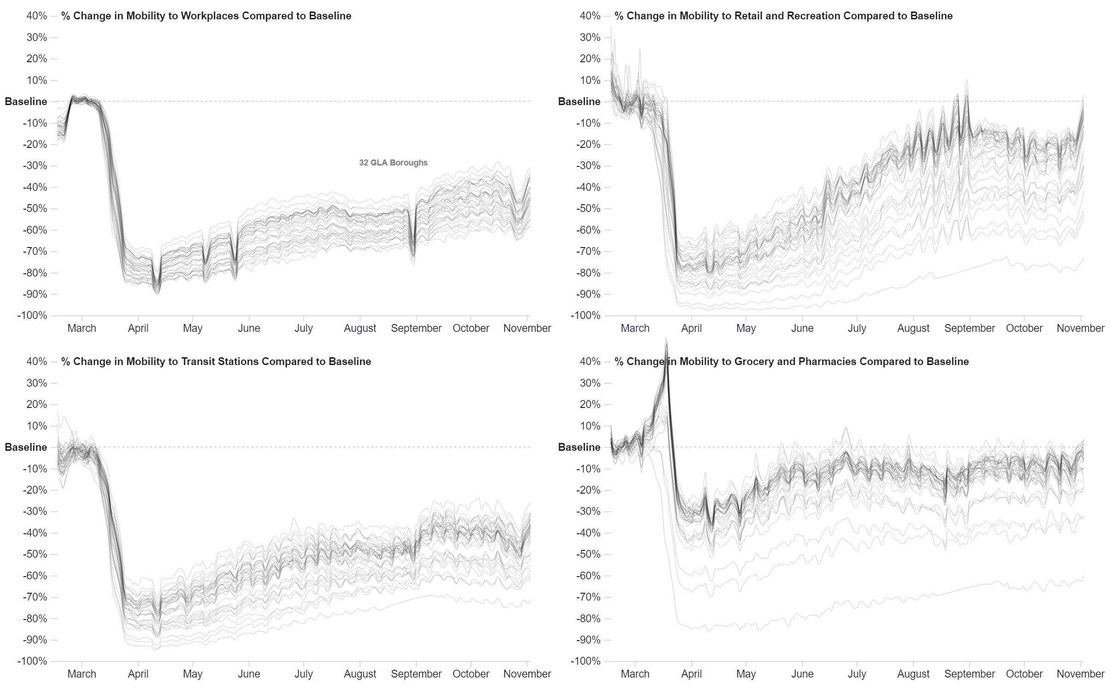

Slide 23
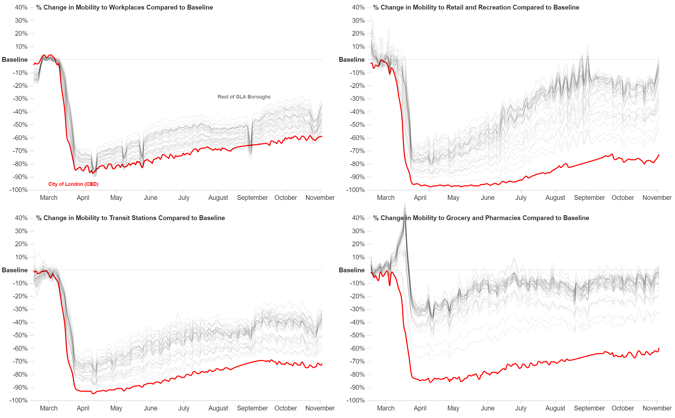

Slide 24
How Does London Compare?

Slide 25
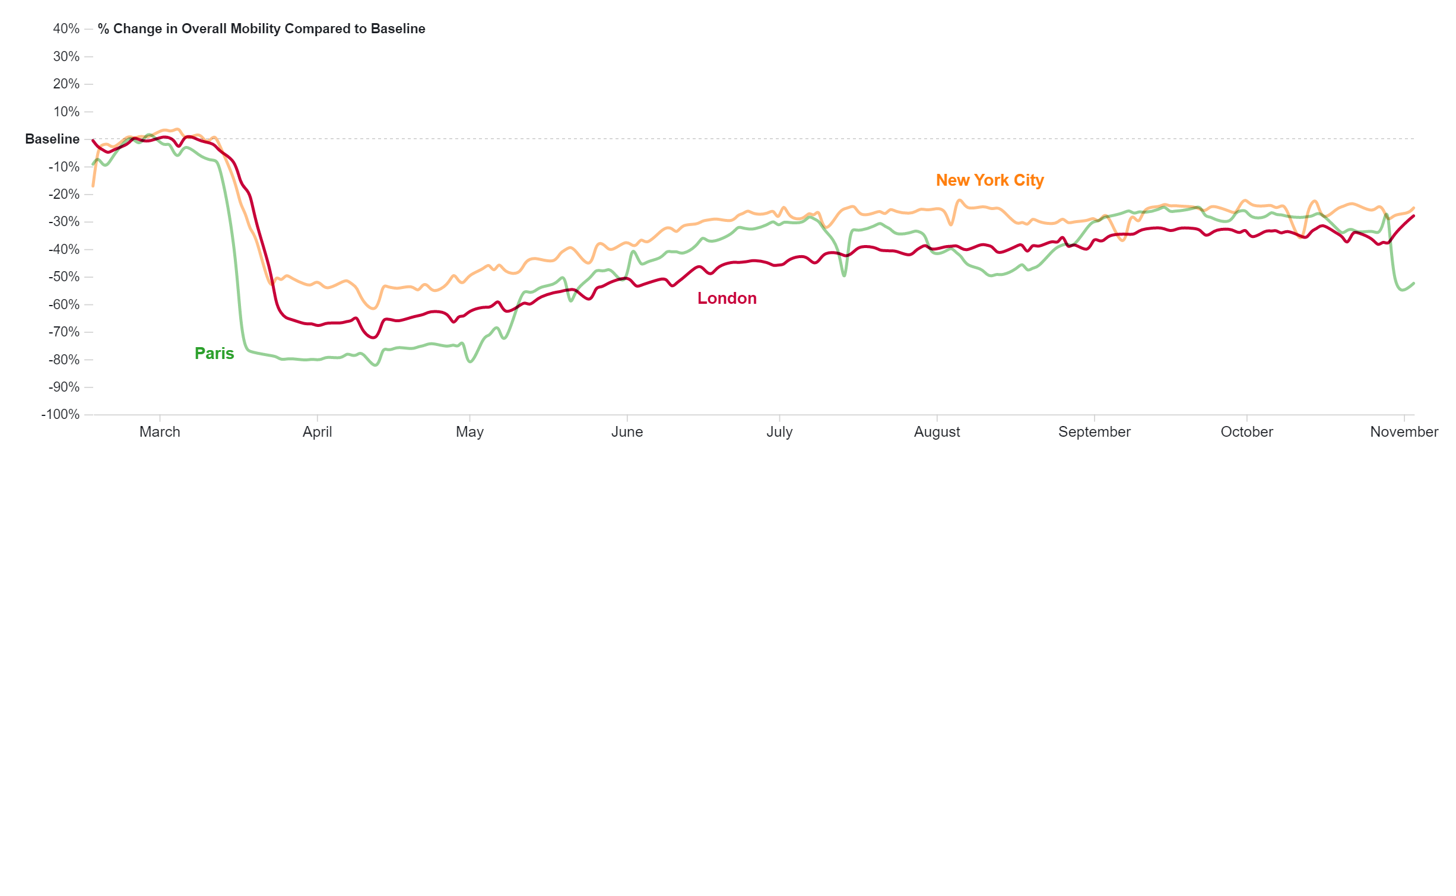

Slide 26
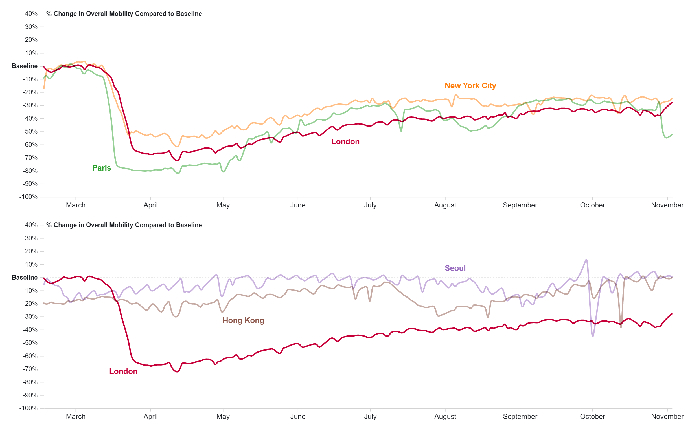

Slide 27
Thank You
Caroline Cullinan
c.g.cullinan@student.tudelft.nl
Leonardo Nicoletti
l.a.nicoletti@student.tudelft.nl

